Slide 1

Google Data Analytics Professional
Capstone Project
Case Study: How Does a Bike-Share Navigate Speedy Success?
Data Provided by Divvy Bikes: 12-Month-Data

Slide 2
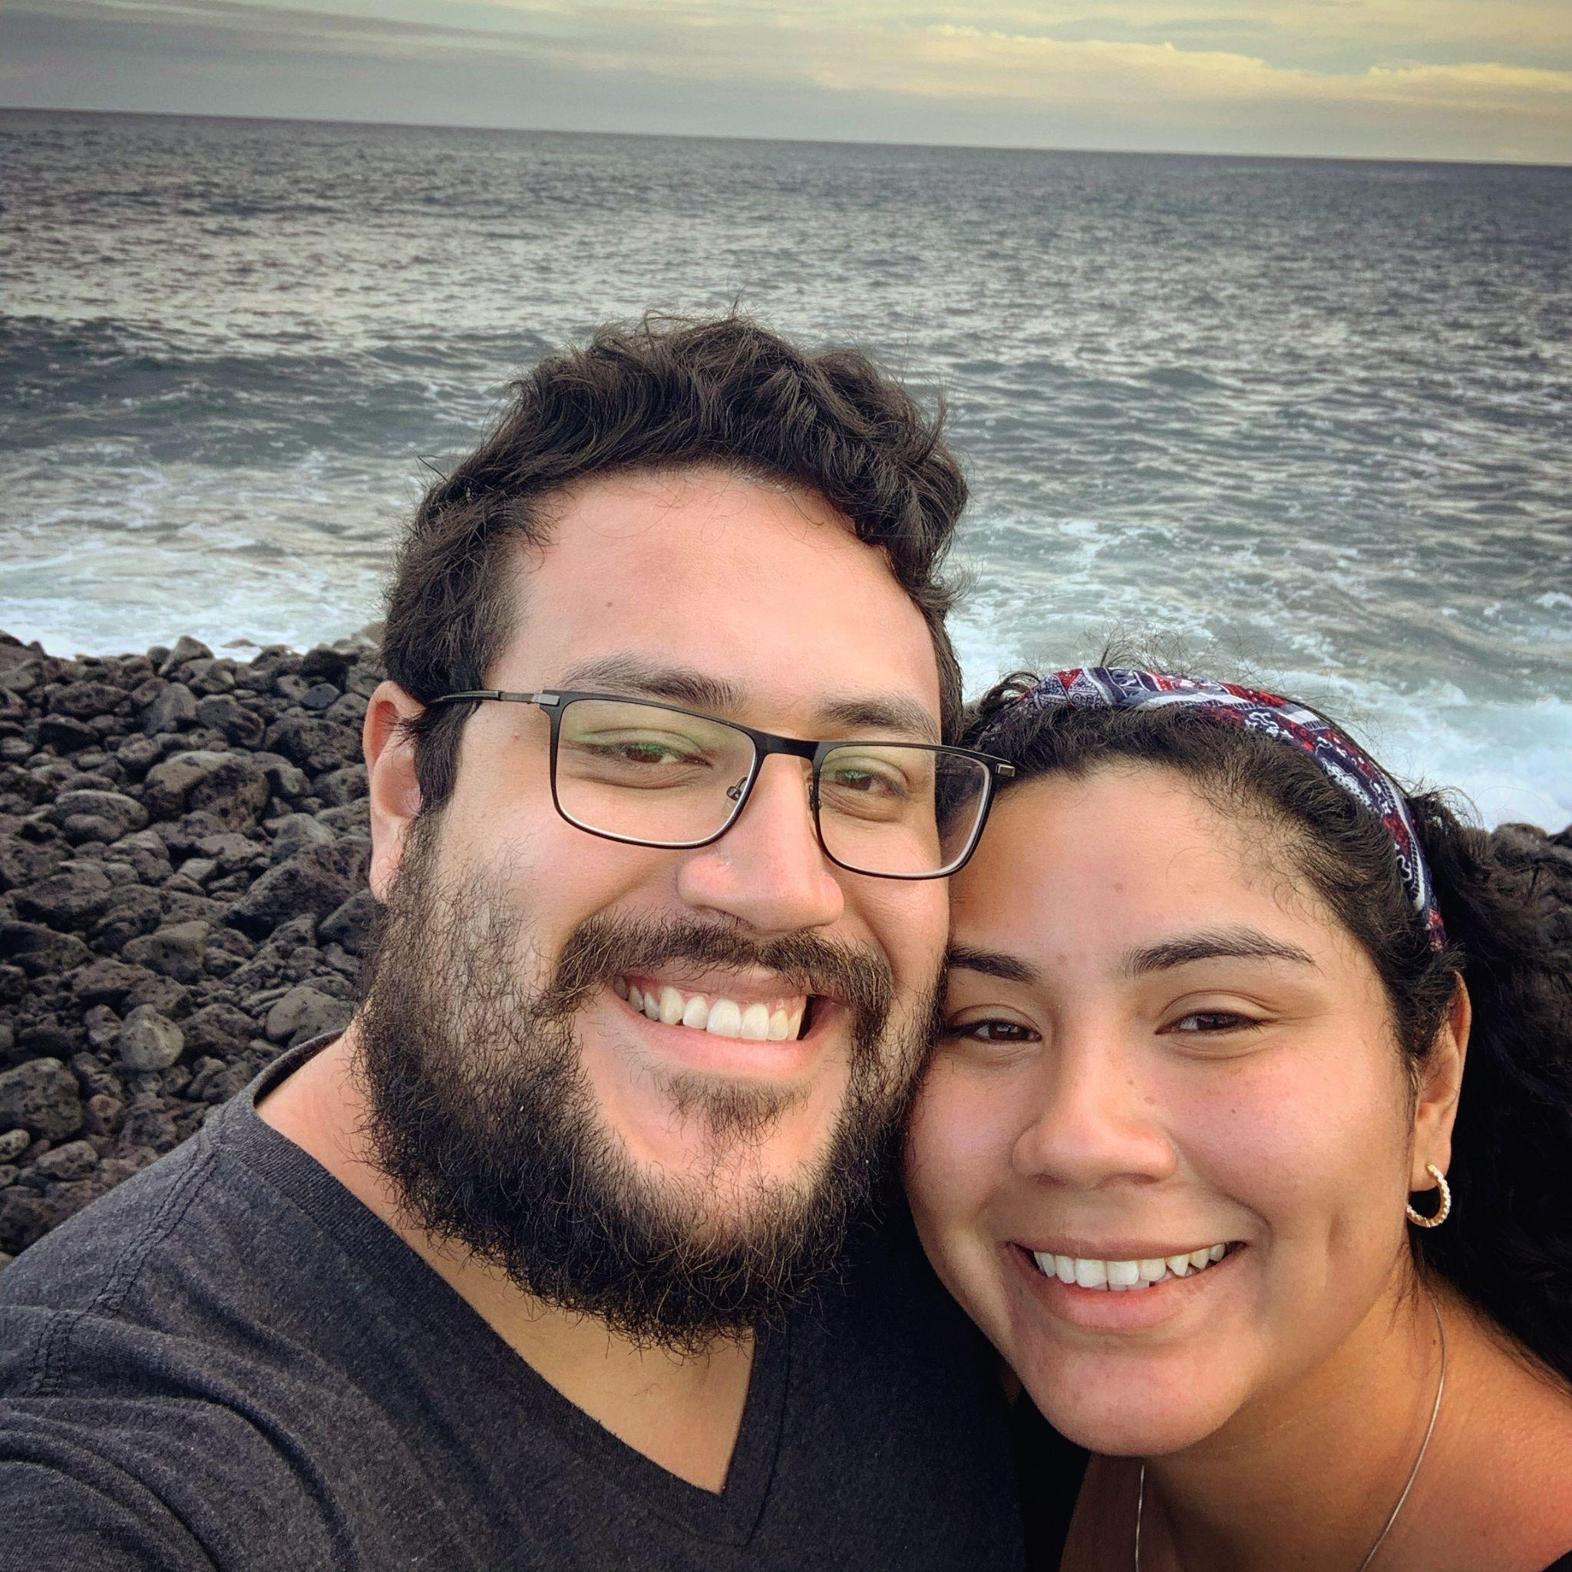
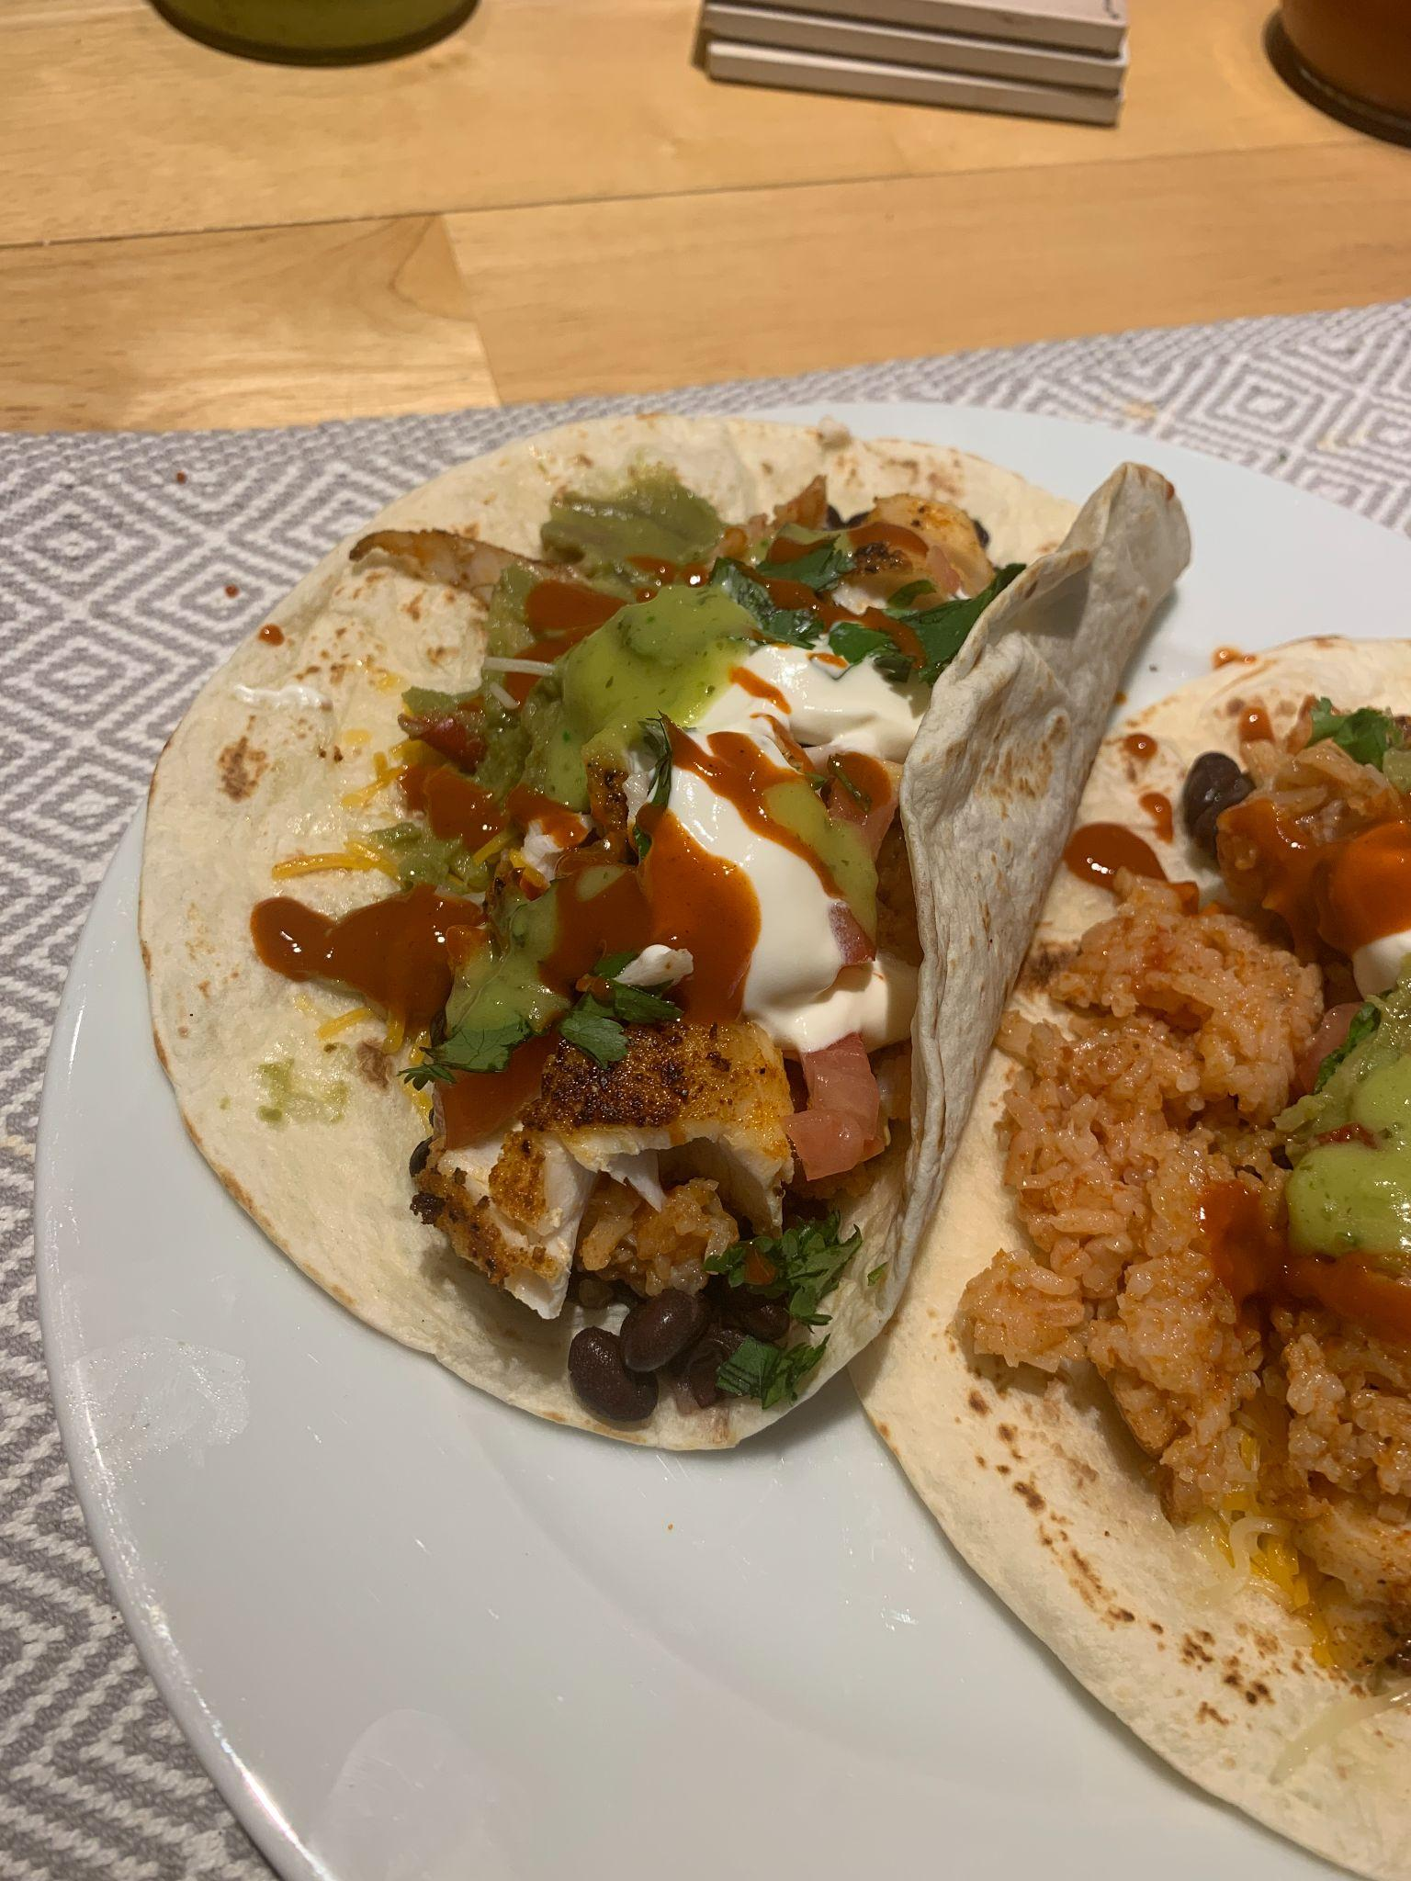
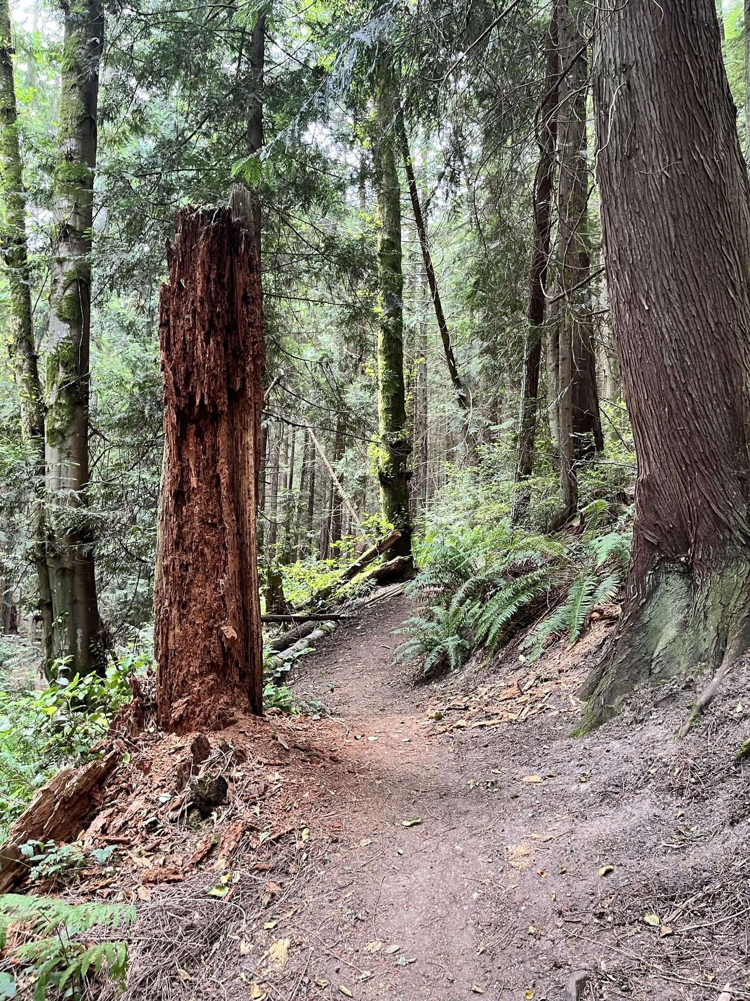

Junior Data Analyst Introduction
Name is Christian Gabriel Carlos
I am an aspiring Data Analyst
My Hobbies are Hiking, Cooking, and Exploring places with my fiance
Joined Coursera's Google Data Analytics Certificate ~Feb
What I Learned:
Data Analysis Process
Skills gained: Data Analysis, Spreadsheets, SQL, and R

Slide 3
Company Introduction
Cyclistic, a bike-share company in Chicago
The bike share program contains 5,800 bicycles and 600 docking stations
Types of bikes: (reclining , hand tricycles, cargo, docking, electric, etc)
Uses cases are for leisure and to commute to work
Two types of subscriptions
Casual Riders - Customer purchases full-day pass or single ride
Cyclistic Members - Annual Membership
Data Provided by Divvy Bikes: 12-Month-Data

Slide 4
Project Objective
Cyclistic’s marketing strategy relied on building general awareness and appealing to broad consumer segments
Cyclistic’s finance analysts have concluded that annual members are much more profitable than casual riders
Proposal is, maximizing the number of annual members with a new marketing program
Three questions will guide the future marketing program:
How do annual members and casual riders use Cyclistic bikes differently?
Why would casual riders buy Cyclistic annual memberships?
How can Cyclistic use digital media to influence casual riders to become members?
Data Provided by Divvy Bikes: 12-Month-Data

Slide 5
How do annual members and casual riders use Cyclistic bikes differently?
We will analyze 2021 annual trip data for both member and casual riders
The High level analysis :
Average ride time for riders
Maximum ride time for riders
Mode (most frequently occurred value) of day of the week
We will explore further by analyzing weekly, monthly, and quarterly trends
In addition, we will combine the analysis by adding different ride types (classic, docking, electric)
Data Provided by Divvy Bikes: 12-Month-Data

Slide 6
High Level Analysis
Average ride time = 0:20:44 (HH:MM:SS)
Maximum ride time = 22:57:39
Filtering data showed this was a casual rider
Day of week was Saturday
Day of week mode = Saturday
Assumptions:
Both riders ride Cyclistic bicycles for ~20 minutes
Riders preferred day to ride Cyclistic bicycles is Saturday
Data Provided by Divvy Bikes: 12-Month-Data

Slide 7
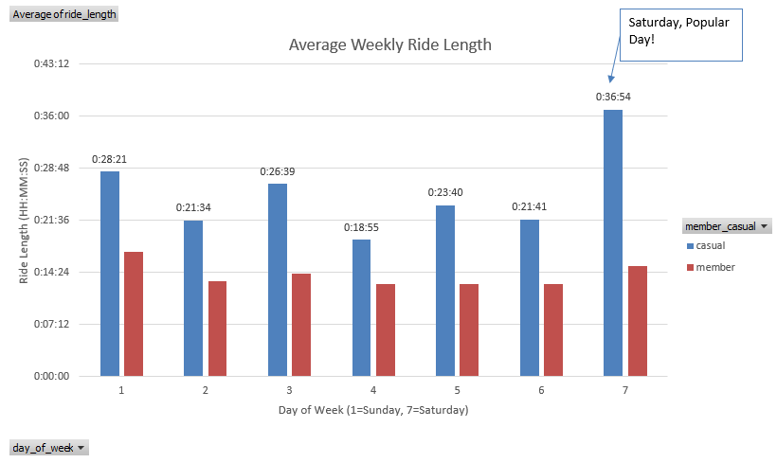
Weekly Ride Length
Average Time Weekly:
Casual = 0:25:23
Member = 0:14:04
Casual riders use bicycles 64.1 % more than member riders
Weekly Percentage Usage:
Casual = 32.1 % Increase
Member = 13.3 % Decrease
Saturday stands out, casual riders average time ~37 minutes
Data Provided by Divvy Bikes: 12-Month-Data

Slide 8
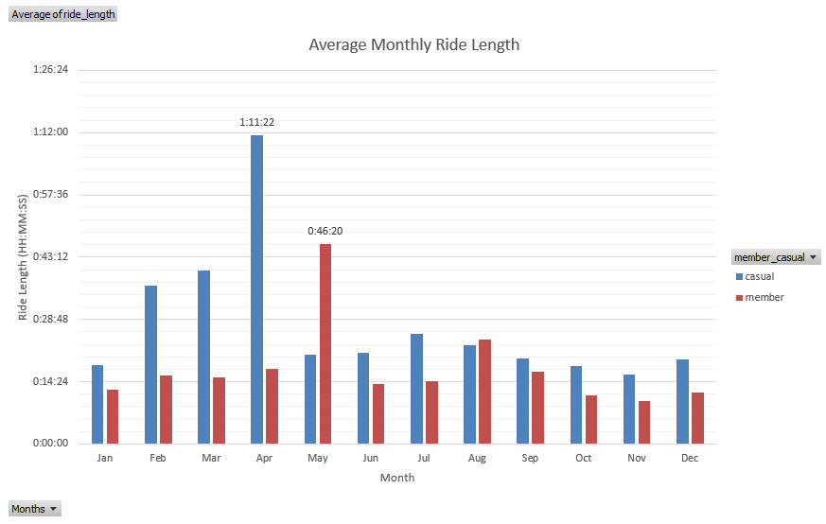
Monthly Ride Length
Average Time Monthly:
Casual = 0:27:28
Member = 0:17:29
Casual riders use bicycles 61.4 % more than member riders monthly
April & May stand out for casual/member riders
Maximum ride (casual) = 1:11:22
Maximum ride (member) = 0:46:20
Data Provided by Divvy Bikes: 12-Month-Data

Slide 9
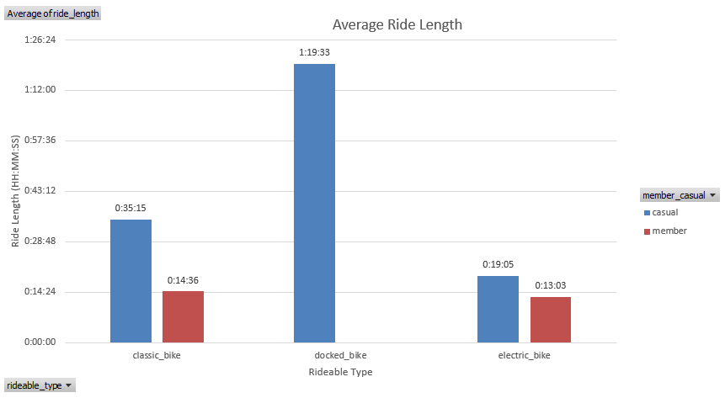
Ride Length (Rideable Type)
Percentage usage (Rideable Type):
Classic
Casual = 71.4 %
Member = 28.6 %
Docked
Casual = 100%
Member = 0%
Electric
Casual = 59.4 %
Member = 40.6 %
Data Provided by Divvy Bikes: 12-Month-Data

Slide 10
Tableau Dashboard - Rideable Type Analysis
Dashboard = Case Study - Rideable type analysis
From Rideable Type Data:
Classic bikes:
Member riders are more likely to use classic bikes than casual riders
Members had a maximum ride's of 449 in February & weekly average of 55 rides per week
Stand out quarter is Q1 2021 where members used < 1000 rides
Docked bikes:
Only casual riders used docked bikes in 2021
Very few rides, average ~75 rides throughout the year
April had a maximum of 103 rides
Electric bikes:
Casual riders more than doubled the average & maximum of member riders
Weekly Average = 67
Month Maximum = 682
Q2 & Q3 casual riders had > 1000 rides
Q4 casual and member riders were about equal in rides
Data Provided by Divvy Bikes: 12-Month-Data

Slide 11
Conclusion
Question = How do annual members and casual riders use Cyclistic bikes differently?
Casual Riders:
Average weekly and monthly rides are more than ~25-27 minutes
Prefer to use electric bikes for smaller trips ~ 19 minutes
For longer rides, used docked & classic bikes more than 30 min - 1 hour
Only used docked bikes the whole year of 2021
Q2-Q4 was their strongest quarter for electric bike usage
Member Riders:
Average weekly and monthly rides were rough ~14-17 minutes
Only used classic or electric bikes for trips ~14 minutes
Q1 was their strongest quarter for classic bike usage
Q4 was their strongest quarter for electric bike usage
Potential next steps?
Apply advertisements in specific time frame on a quarterly basis
Change ride requirements for casual and member users in order to get full benefits of a member user
Recognition: I would like to thank google for providing access to the twelve month trip data
Data Provided by Divvy Bikes: 12-Month-Data

Slide 12
Q/A
Any Questions?

